Slide 1
Overview of Domestic Abuse in Northern Ireland and impact of the pandemic
Probation Board for Northern Ireland
Kelly Andrews
Chief Executive Belfast & Lisburn Women’s Aid

Slide 2
Introduction
Domestic Abuse in Northern Ireland
Women’s Aid Regional picture
Impact of the Pandemic
Responding to the Pandemic
Multi-agency collaboration
New legislative Protections
Violence Against Women & Girls

Slide 3
Domestic Abuse in Northern Ireland
From 1st January - 31st December 2021, there were 20,827 domestic abuse crimes recorded by the Police across Northern Ireland: the highest number recorded in a 12-month period since records began.
In the same period, the Police recorded 32,219 domestic abuse incidents recorded - an average of over 88 incidents per day.
From 1st February 2021 - 31st January 2022, seven women in Northern Ireland were murdered with a domestic abuse motivation recorded by the Police

Slide 4
Women's Aid in Northern Ireland
The lead voluntary organisation in Northern Ireland addressing domestic abuse and providing services for women and children.
Made up of eight local Women’s Aid groups and Women’s Aid Federation.
Exists to challenge attitudes, structures and systems which perpetuate domestic abuse.
Strong ethos of women, with women, by women.

Slide 5
Women’s Aid Regional picture
In the 2020-21 financial year Women's Aid...
Housed 530 women and 319 children in refuge accommodation
Supported 6005 women and 6450 children in the community
293 Women who were pregnant received support
10 Babies born to women in refuge

Slide 6
Belfast & Lisburn Women's Aid
In the 2020-21 financial year Belfast & Lisburn Women's Aid...
Housed 266 women and 163 children in refuge accommodation
Supported 814 women and 1,095 children in the community
Supported 66 women and 27 children in the Trafficking Project

Slide 7
Impact of the pandemic
The Covid-19 Pandemic presented us all with unprecedented challenges
As an organisation we recognised the impact of lockdown on women and children
Increased chance of abuse, increase in fear and risk
Reduced access to services
Since the first lockdown in March 2022, 13 women have been murdered in a domestic environment

Slide 8
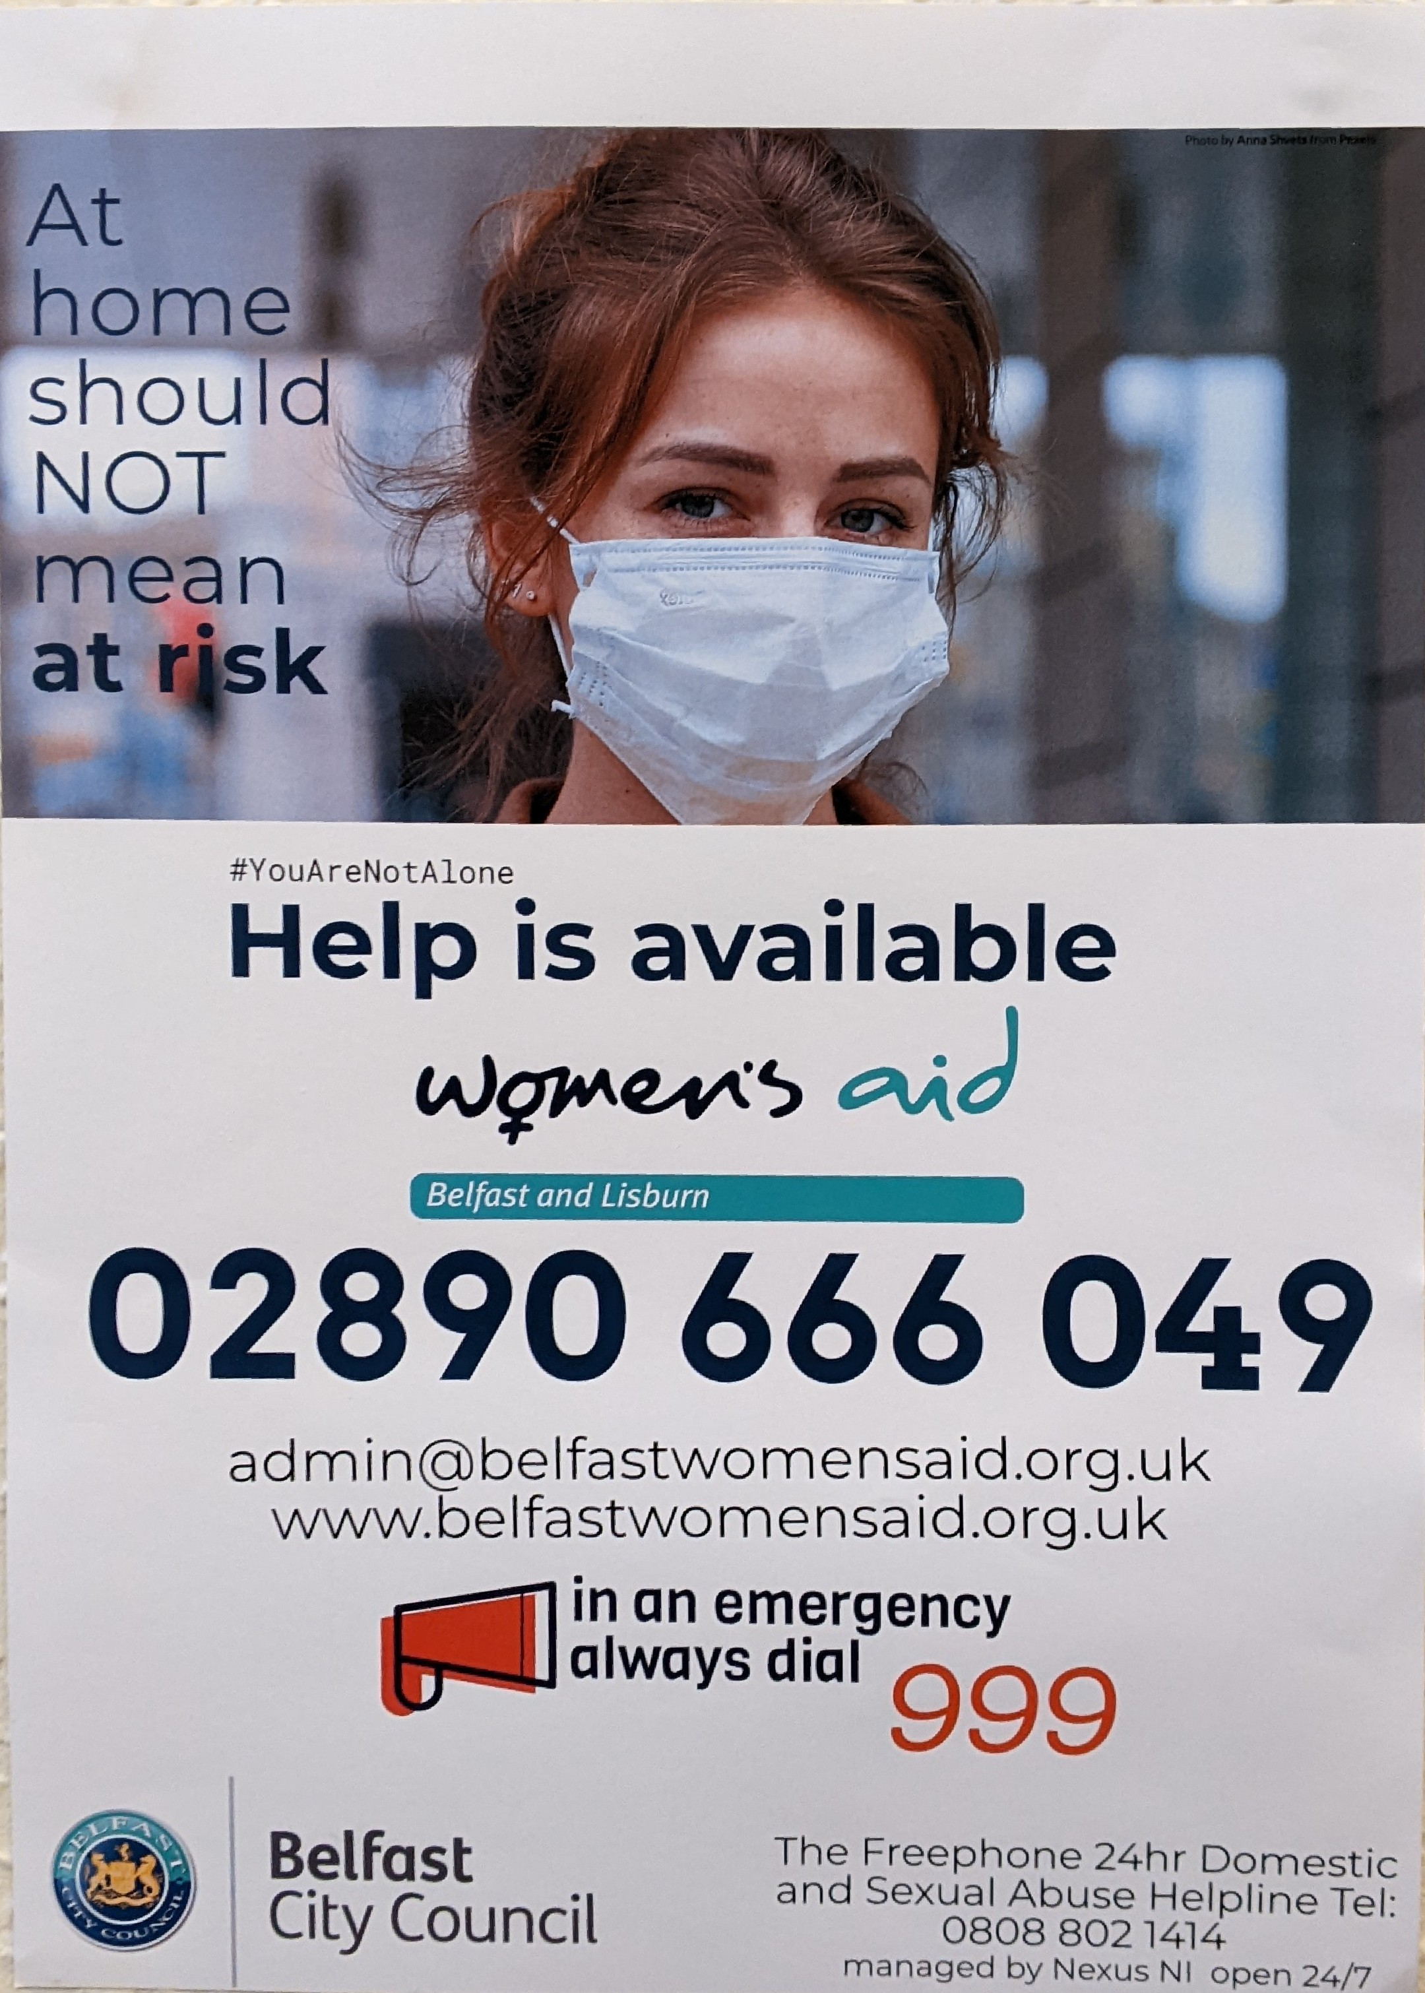
Responding to the pandemic
Imperative we remained open and accessible
Emergency housing provision provided
Responding to community need-floating support service
Implemented Webchat service
Launched an ‘At Home should not mean at Risk’ campaign (Funded by Belfast City Council & the NIHE) (‘Communications in a Crisis’ Winner Charter Institute of Housing Awards 2021)
Followed by very successful Regional 'Unlock your lockdown' campaign

Slide 9
Multi-agency collaboration
Women’s Aid coordinated approach
The NIHE/Supporting People worked extremely closely with us during the lockdowns, were available 24/7
Police Service in Northern Ireland (PSNI)
Probation Board of Northern Ireland (Promoting Positive Relationship Programme)
Social Services/ Trusts provided PPE
Local Councils (Belfast City Council funded BLWA to provide food/support with utilities to women and children impacted by domestic abuse.

Slide 10
New Advocacy Service
The Department of Justice and the Police Service of Northern Ireland commission new advocacy service in January 2021
Contracted awarded in Belfast & Lisburn Women’s Aid, Men’s Advisory Project and Foyle Family Justice Centre who formed a consortium ‘ASSIST NI’
This new Domestic and Sexual Abuse Advocacy service has been operational for 6 months
ASSIST NI has received 8731 adult referral and 752 Child referrals.

Slide 11
New legislative protections
Domestic Abuse and Civil Proceedings Act (Northern Ireland) 2021 (This law became operational in February 2022)
The Protection from Stalking Bill passed the final stage in the Northern Ireland Assembly on the 22 February 2022.
The Justice (Sexual Offences and Trafficking Victims) Bill (February 2022) (Non fatal strangulation/ removes rough sex defence)

Slide 12
Domestic Homicide Reviews
Domestic Homicide Reviews were introduced into Northern Ireland in 2021.
There are currently five DHRs live.

Slide 13
Violence Against Women & Girls Strategy
We are the only part of the UK that does not recognise domestic violence and abuse as a gendered crime and does not have a VAWG Strategy.
On International Women’s Day 2021 Women’s Aid NI launched a petition calling for a VAWG Strategy
MPs from Westminster and local MLAs supported this campaign
The First and Deputy First Ministers announced their commitment to a VAWG Strategy
Officials in the Executive Office have been tasked, therefore, with bringing forward a new Strategy - the Equally Safe Strategy (a Strategy to Tackle Violence Against Women and Girls).

Slide 14
Further progress required
Women’s Aid will continue to lobby for equity of legal protection for victims and survivors in Northern Ireland
Domestic Abuse Commissioner and office
Serial perpetrator register domestic abuse and stalking for the whole Domestic Abuse Commissioner and office
Full review of the Family Courts and review of child contact system
Review of tendering and procurement for specialist services such as domestic and sexual violence services
Changes to housing and homelessness legislation for those escaping domestic violence and abuse to ensure same as GB – secure tenancies for all domestic abuse survivors
Ensure that welfare policies protect women and their children
Reforms to ensure migrant survivors have equal access to protection and support

Slide 15
Continued...
Funding and resourcing of the current Domestic Abuse & Civil Proceedings Act 2021 which is essential to respond to domestic violence and abuse
Review of the MARAC process
Domestic Abuse specialist courts
Training for all Judges
Ratification of the Istanbul Convention

Slide 16
Thank you

