Slide 1
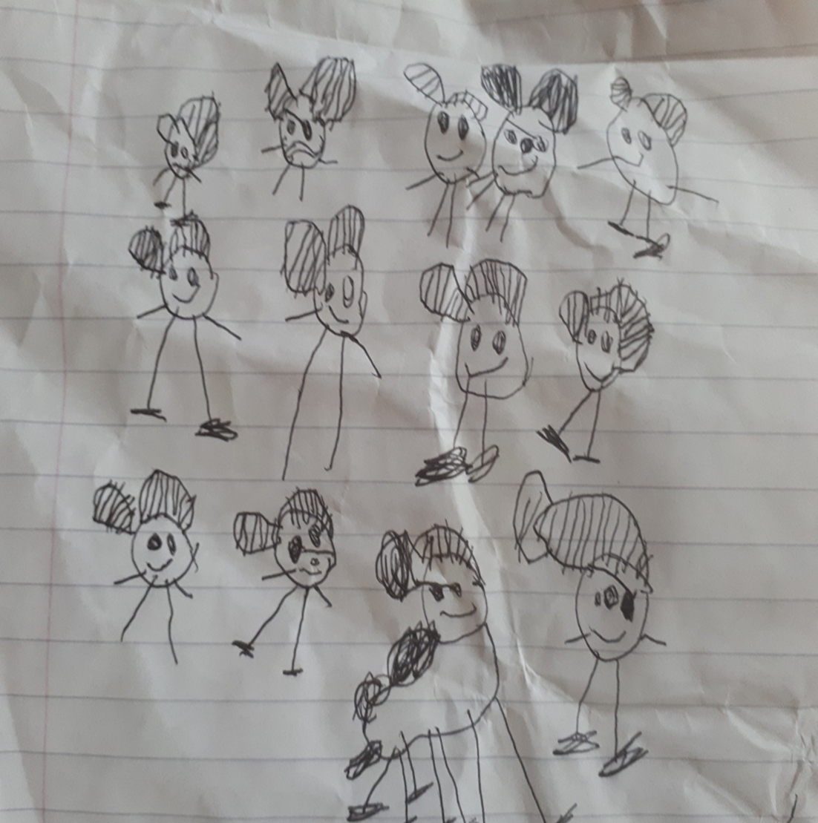
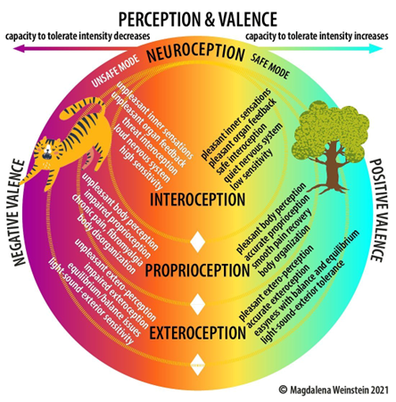
The importance of nervous system awareness when working with people on Probation
PBNI conference
Belfast 28/03/23
Dr Jane Mulcahy
@janehmul
jane.mulcahy@ul.ie
Ubuntu: I am because we are

Slide 2
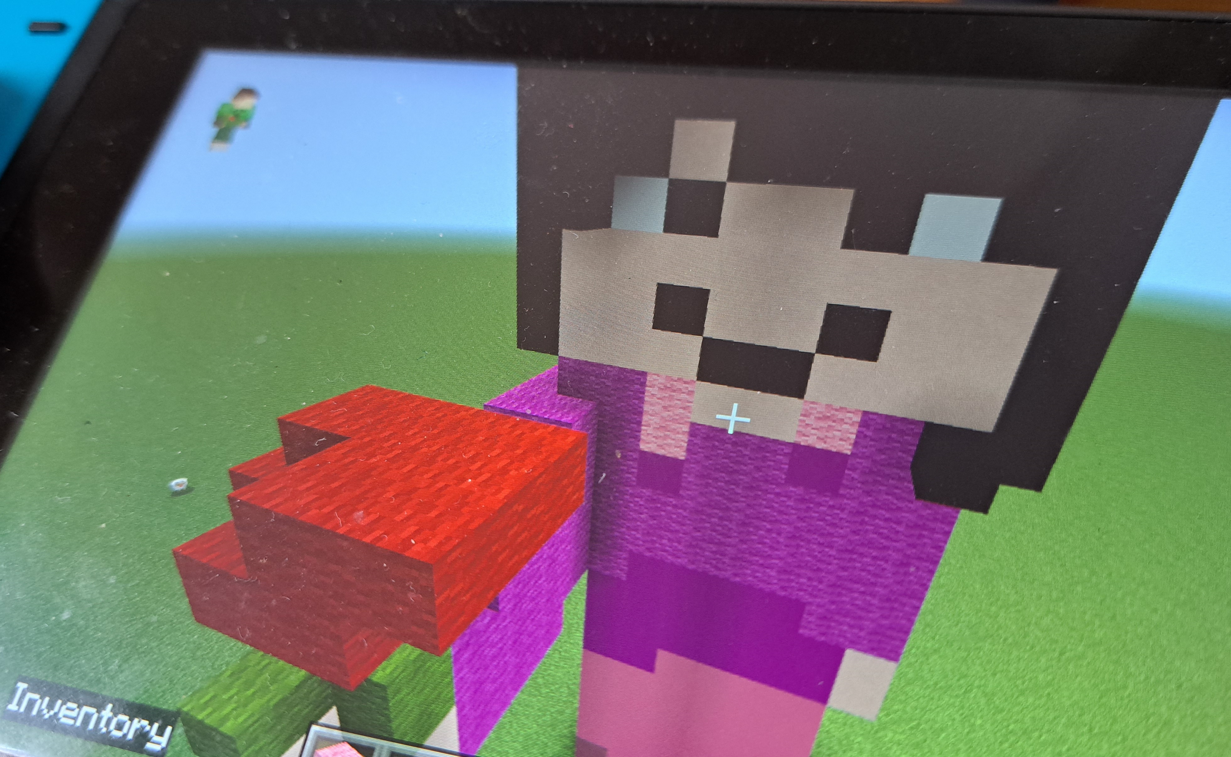
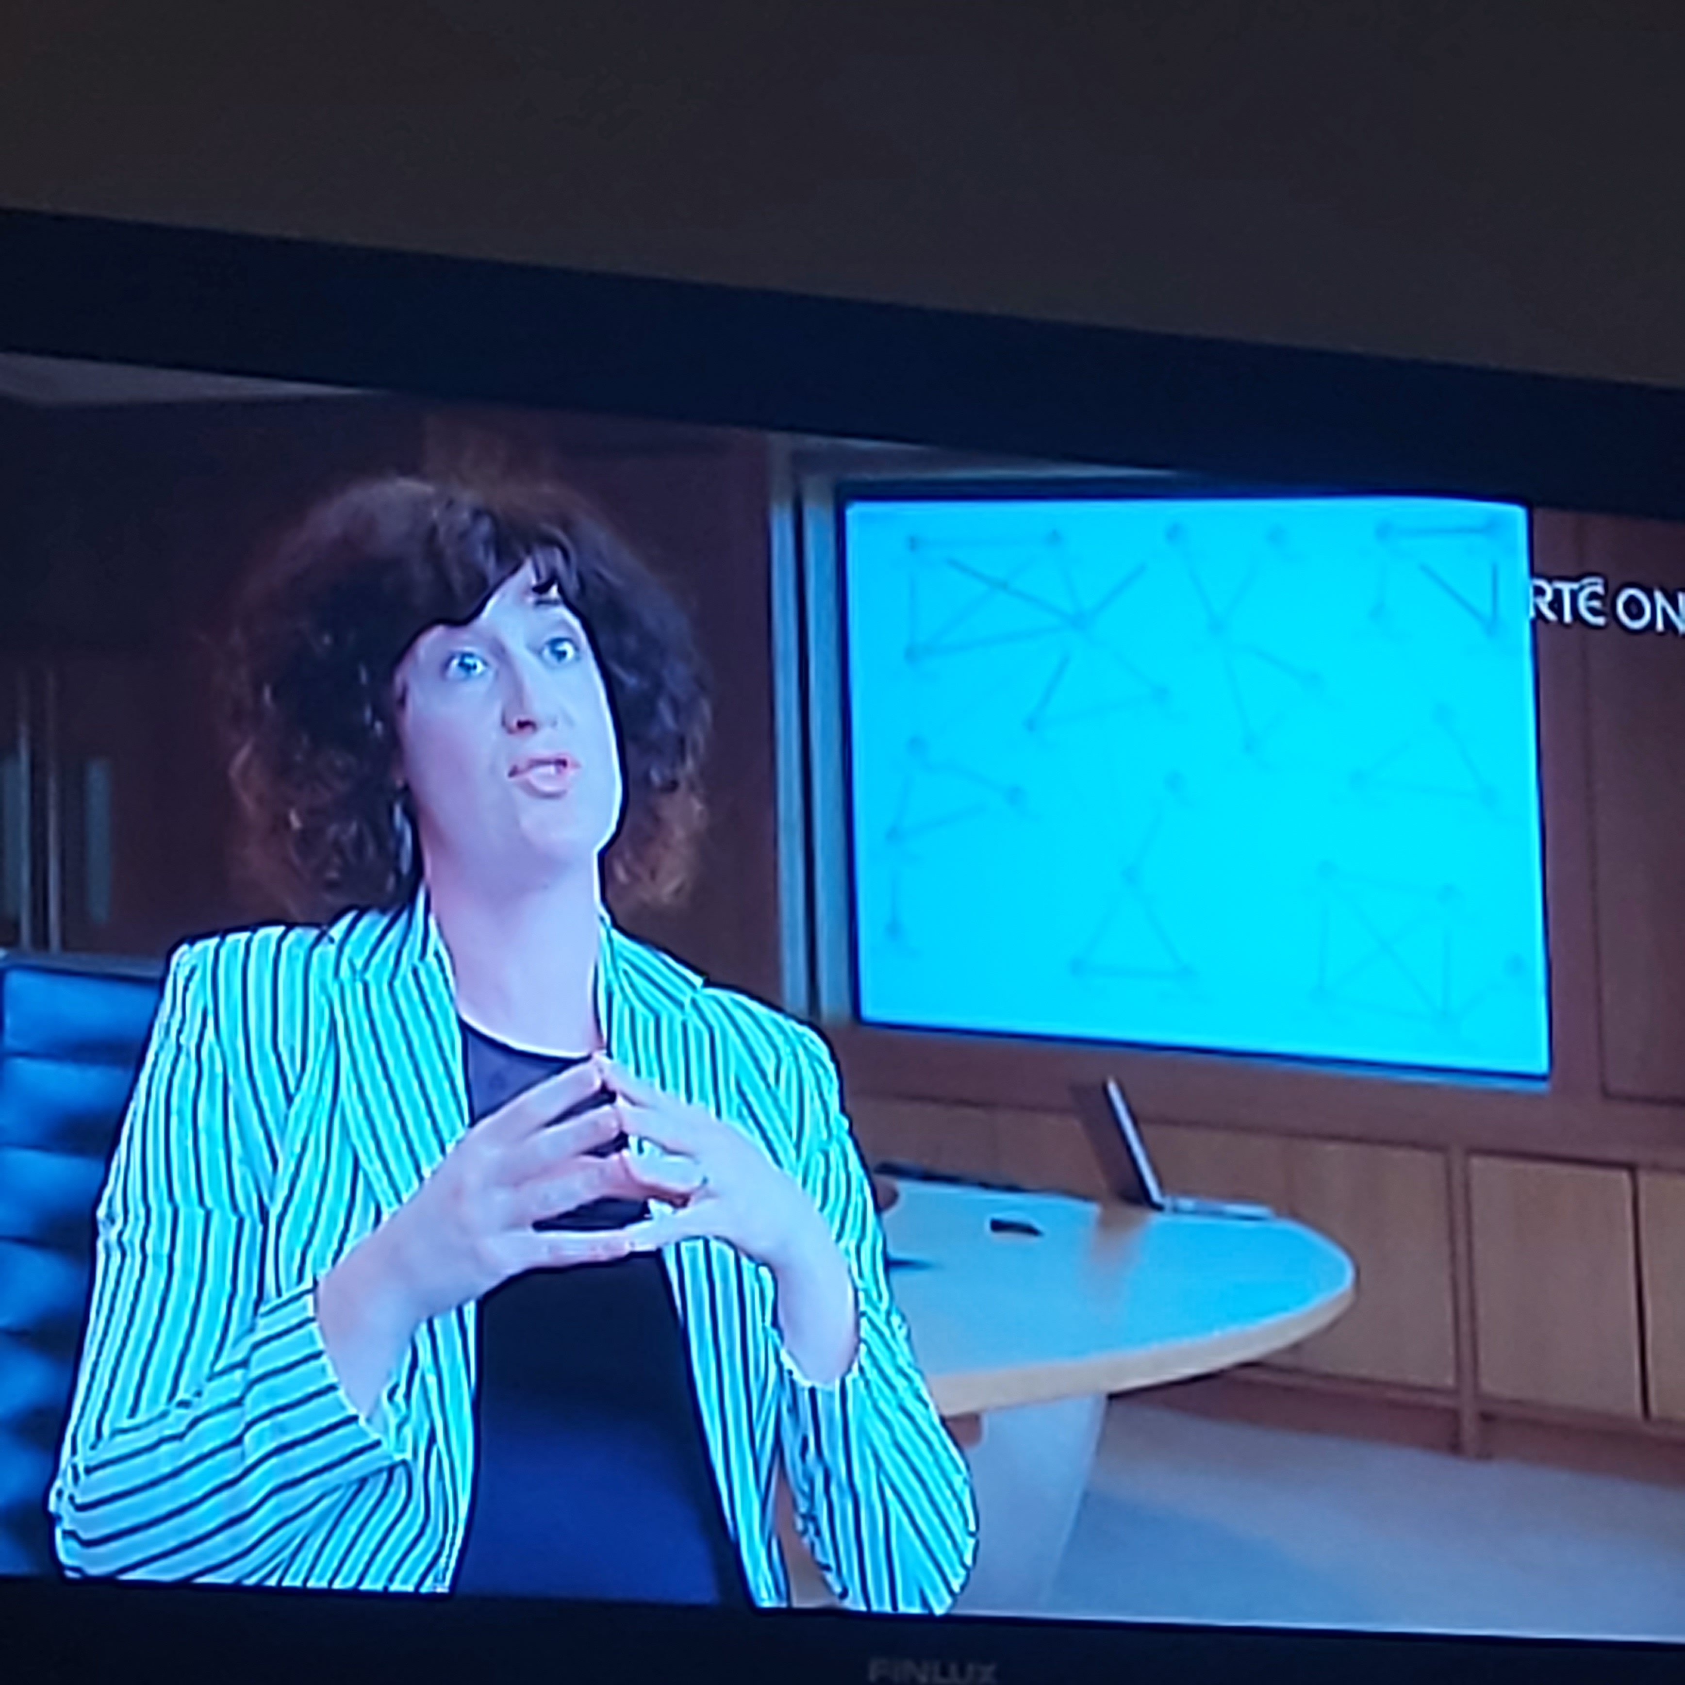
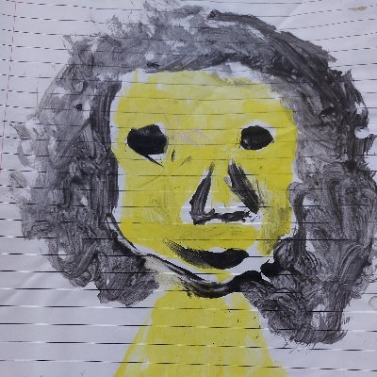
Who am I?
A mom of two beautiful, smart, funny, frustrating children
A wife
A daughter
A sister
A friend
A woman with a PhD in Law (which is very focused on trauma)
A Research Fellow with REPPP at University of Limerick
An activist
A podcaster
A former theatre-maker (director, actor, playwright)
A budding Design Thinker
A Movement Medicine enthusiast
A yoga fanatic (since November 2022)
An energetic field (Tolle, Hübl, Scharmer)

Slide 3
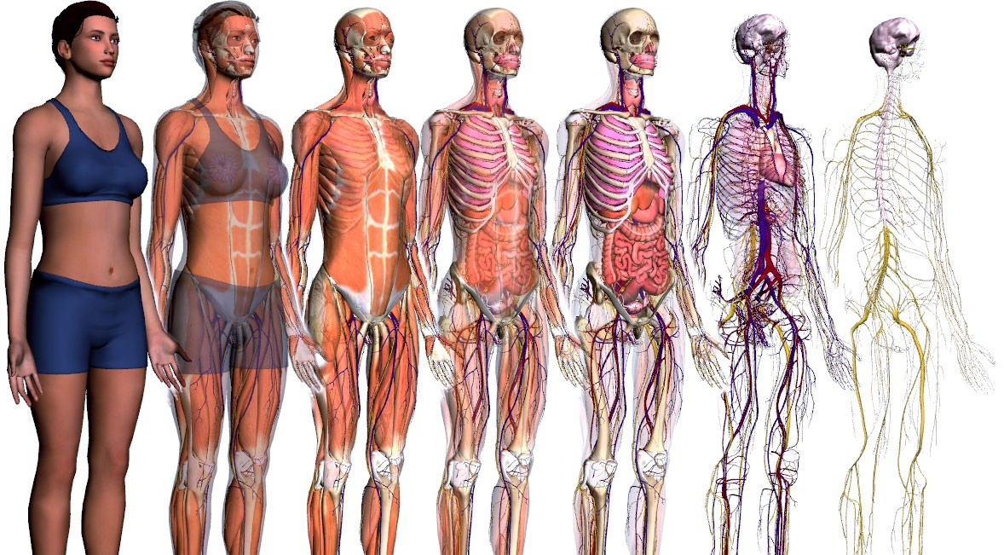
This presentation will touch on:
Attachment as a biological drive
The importance of nurturant care
Interpersonal neurobiology
Polyvagal theory – the science of safety
The impact of insecure & disorganised attachment
The relational dimension of Probation work involves co-regulation (how the nervous of system of the Probation Officer can potentially calm the nervous system of a dysregulated person before them)
Managing risk – is “neural state is the intervening variable” (Porges)???
Traumatic re-enactment
Please embrace the invitation to tune into your own body & nervous system.
What sensations do you notice? Do you feel constriction/discomfort/dis-ease?
What is the quality of your attention? How is your heart? Your breath? Where can you soften? Where can you let go? (Hasti Yavarti)

Slide 4
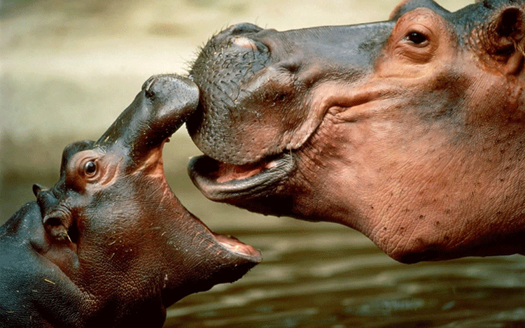
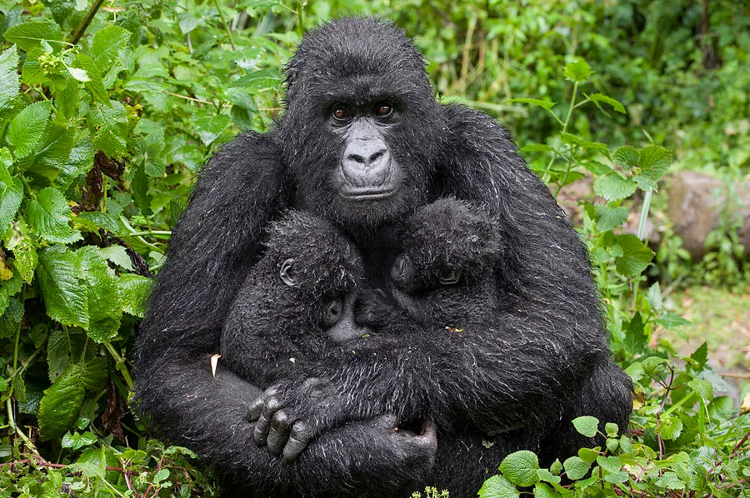
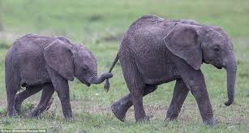
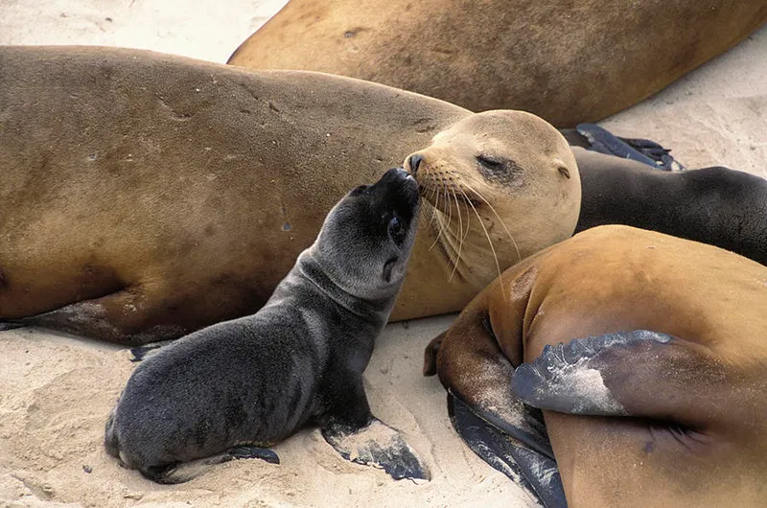

Slide 5
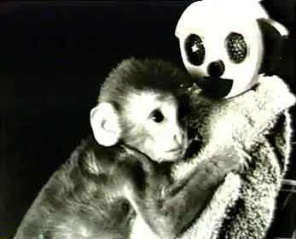
Harlow’s Monkeys study - https://www.youtube.com/watch?v=_O60TYAIgC4

Slide 6
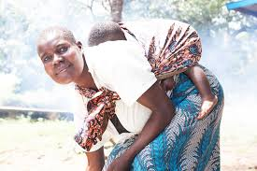

Slide 7
Resilient children are “made, not born” (Szalvitz & Perry, The Boy Who Was Raised as a Dog 2017:38)
Children are not resilient, but rather “malleable": adaptable and capable of being of moulded by their environment.
Children’s emotional safety derives from their parents. A baby’s development is “experience dependent” (Hambrick et al (2019).
Growing up in a safe, nurturing, comfortable home with an attuned caregiver, where basic human needs are met, in a community that is not perpetually under siege, is a prerequisite for healthy child development and ultimately for societal health and stability.

Slide 8
The quality of care-giving received in infancy
The parent child connection is, according to Bessel Van der Kolk, “the most powerful mental health intervention known to mankind”.
Unless infants get positive care and affection, they are unlikely to experience normal physical or emotional development. According to Dr Bruce Perry:
Without predictable, responsive, nurturing and sensory-enriched caregiving, the infant's potential for normal bonding and attachments will be unrealized. The brain systems responsible for healthy emotional relationships will not develop in an optimal way without the right kinds of experiences at the right times in life. (2013:3)

Slide 9
Memory templates (Perry, 2017): “Like attachment and early childhood experiences will inform who comes through those doors, and who doesn’t.” (PhD Focus Group participant)
“The primary ingredient of secure attachment experiences is the pattern of ‘emotional communication’ between child and caregiver.” Siegel (2015), 12
https://www.heraldscotland.com/politics/19700034.scotlands-violent-crime-epidemic-can-solved-war-poverty-womb/ (Niven Rennie’s comments on trauma, poverty & violence)
Memory is “the way past events affect future functioning.” Siegel (2015), 46
Winnicott’s concepts of “good enough mother” & holding environment
“Lick your pups” – Burke Harrris (2018)

Slide 10
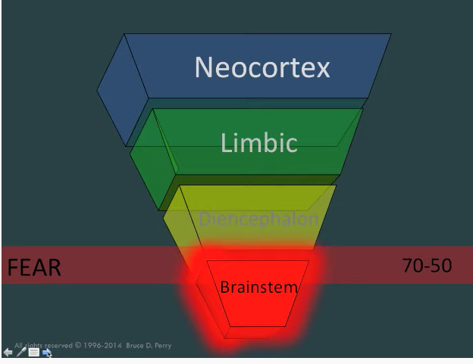
The human brain & state dependent functioning (Perry)
SevenSlideSeries: State-dependent Functioning
https://www.youtube.com/watch?v=1uCn7VX6BPQ
Daniel Siegel Hand Model (2015)
https://www.youtube.com/watch?v=qFTljLo1bK8

Slide 11
Neural pathways & the autonomic nervous system
The nature of “interpersonal neurobiology “(Siegel, 2015) is that our brains develop (and change) in the context of experience & relationships.
Neural connections are “use dependent” – use them or lose them (Perry, 2017 edition). As far back as 1949, Donald Hebb, a Canadian neuropsychologist, had explained that neural pathways become stronger with repeated use. Hebb’s rule is usually summarised as “neurons that fire together wire together”.
If we become chronically stressed as babies because our care-givers are frightening, or because they ignore us due to severe depression or debilitating drug or alcohol use, we do not have the luxury of being playful or curious, keen to explore our environment.
Exposure to overwhelming stress in infancy means that the neurons we use and, therefore, wire together are those linked to our brain’s survival apparatus, not our prefrontal cortex.
Fear causes the production of cortisol in children, which activates the autonomic nervous system (ANS), i.e. a fawn/fight/flight/freeze or collapse/shutdown response. The development of normal neural pathways is stunted.
(See Still Face Experiment: Dr. Edward Tronick available at https://www.youtube.com/watch?v=apzXGEbZht0)

Slide 12
Frightened/frightening caregiving, absence of nurturant care & drug-related thefts
CATHAL* – I was in an’ out of care homes. I come from a dysfunctional family. I weren’t given a fair life, to be honest wit’ ya. Djunno?
JM – Yeah. And did you leave school early?
CATHAL – (high pitched) Yeah. I did leave school early. Djunno? Weren’t given a fair life, like. Djunno what I mean?
JM – And so would you think – like when you’ve done the addiction counselling and stuff, why do you think you’ve taken drugs?
CATHAL – (high pitched) For wha’ I was watchin’ at five years of age a’ home. Dat’s where it all started. (high pitched, soft) Watchin’ me mudder ge’ bate by me fa-der. Dat’s where. It all kicked off when I was a small little child wit’ nobody to hug me. (high pitched) I’m gone into all dis in treatment. (high pitched) I know who I am. I know why I am. […] I went back t’rough all dese years. I put it out in groups. I don’t hold in naught’n no more. (pre-release interview)
* Pseudonym meaning Strong in Battle

Slide 13
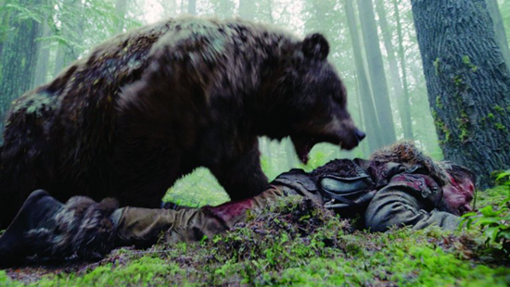
“The healthy, normal, fortunate adult in our culture is largely satisfied in his safety needs. The peaceful, smoothly running, 'good' society ordinarily makes its members feel safe enough from wild animals, extremes of temperature, criminals, assault and murder, tyranny, etc. Therefore, in a very real sense, he no longer has any safety needs as active motivators. Just as a sated man no longer feels hungry, a safe man no longer feels endangered. If we wish to see these needs directly and clearly we must turn to neurotic or near-neurotic individuals, and to the economic and social underdogs.” A.H. Maslow

Slide 14
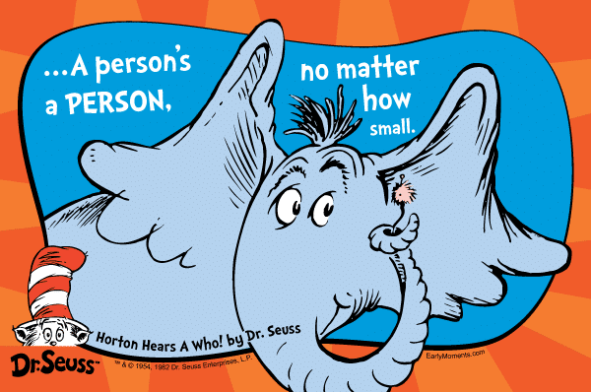
Daring to Ask “What Happened to You?” - Why Correctional Systems Must Become Trauma-Responsive (2018) https://www.researchgate.net/publication/324531733_Daring_to_Ask_What_Happened_to_You_-_Why_Correctional_Systems_Must_Become_Trauma-Responsive
“The focus of prison-based services, Probation and community-based organisations involved in prisoner aftercare should be redirected towards trauma-responsive practice in order to assist unrecovered trauma survivors with offending behaviour to make better sense of themselves and their multiplicity of personal struggles. Offending behaviour is a symptom of trauma, like addiction, psychosocial disability (mental illness), homelessness, & suicide.
Criminality and the consequent loss of liberty may, for many prisoners, be a minor aspect of their personal adversity stories. Offenders tend to come from communities where ACEs are all around them; in their homes, on their streets, in their schools, doctor’s surgeries and emergency rooms. If prisons and probation become trauma-responsive and help people to understand their childhood adversity and its enduring magnitude, they will be more likely to buy into participation in both personal development and offending behaviour interventions.”
Healing begins with safety and is about relationships.
For those working with “unrecovered trauma survivors” (Whitfield, 1998), such as people on Probation, the impact you have on the person before you is considerable: “You are your own best tool”. (However, you may also be your own worst enemy!)
Connected Corrections and Corrected Connections: post-release supervision of long-sentence male prisoners | Request PDF (researchgate.net) (PhD)

Slide 15
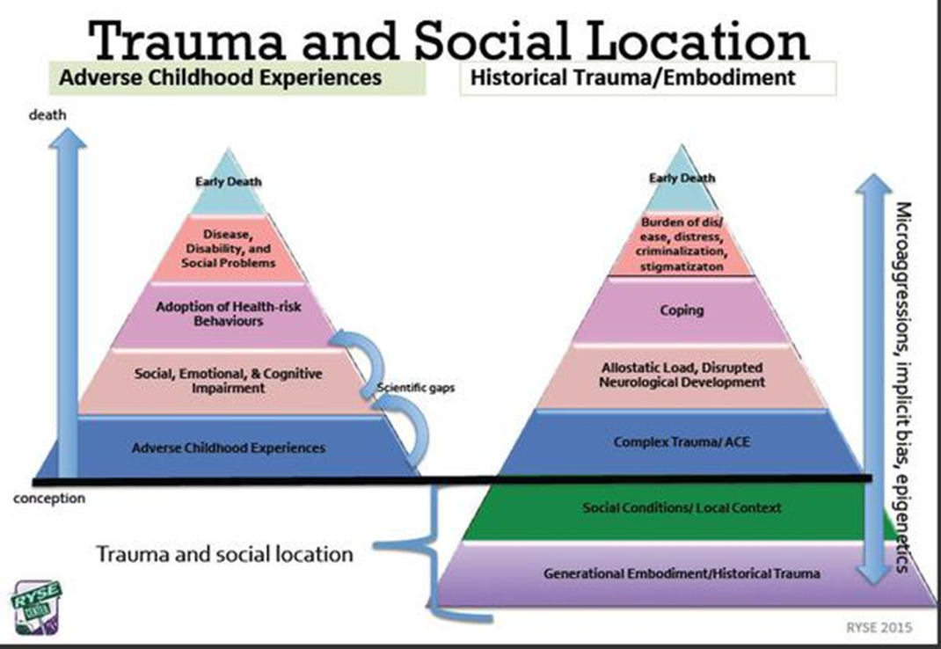
It’s not all just about the individual or family context!
Historical trauma linked to colonisation and “The Troubles”

Slide 16
Rides At The Door M, Shaw S. The Other Side of the ACEs Pyramid: A Healing Framework for Indigenous Communities. Int J Environ Res Public Health. 2023 Feb 25;20(5):4108. doi: 10.3390/ijerph20054108. PMID: 36901119; PMCID: PMC10001615.

Slide 17
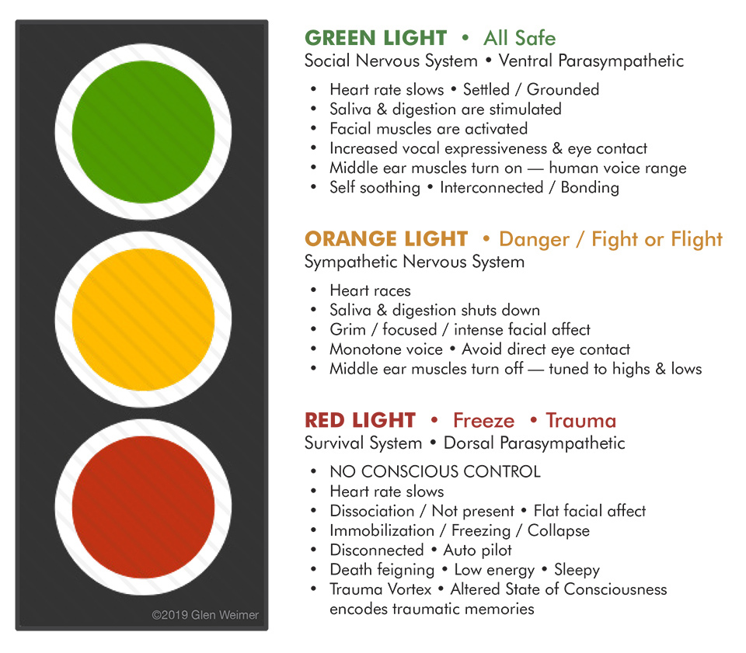
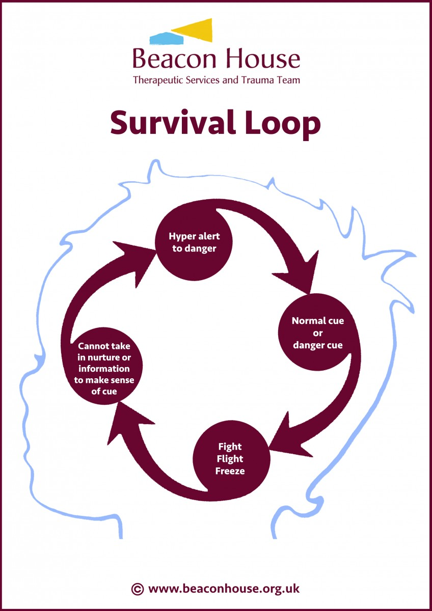
The impact of accumulating stressors (with no co-regulation) = “a nervous system in a chronic state of defence” Porges

Slide 18
Co-regulation, health & social behaviour
Porges describes the nervous system of social behaviour as “the nervous system of health, growth and restoration.”
Our ability to regulate our physiological state is “built on a platform of successful co-regulation”.
Co-regulation is the ability to mutually (synchronously and reciprocally) regulate the physiological and behavioural state of another person. Co-regulation precedes emotional self-regulation in healthy child development. Thus, for optimal brain development and the ability to self-regulate, we must first co-regulate with our primary carer, via attachment. Human sociality starts at birth.
An individual’s “felt sense” (Levine, 1997: 65) of safety, relational health, cortical functioning and capacity to be a productive member of society in adulthood begins with the quality of their preverbal attachment experiences.
See Ansbro, M. A qualitative examination of attachment-based concepts in probation supervision. Probation Journal, (2019) 66(2), 181–200.

Slide 19
Traumatic re-enactment/repetition compulsion
Traumatic re-enactment/repetition compulsion is a psychological phenomenon where people unwittingly repeat the past.
In addition to causing problems in our intimate relationships and with our children when we become parents, our preverbal implicit, procedural memory, attachment style, experience of emotional neglect and trauma history may also present difficulties in our interactions with helping professionals.
Dr Sandy Bloom adopts a powerful theatre metaphor to explain the importance of refusal by authority figures and the social wider group to respond on cue to a person’s trauma scenario. (Creating Sanctuary: Toward the Evolution of Sane Societies, revised ed. (New York, Routledge, 2013) 263-264.
“Traumatic re-enactment is like a traditional piece of theatre where the cast perform the same lines, the same way night after night, with no deviation from the script, no changes to the movements on stage and the same exact ending. Improvisation, by contrast, is more vital and organic. There is no fixed, pre-determined ending or desired outcome. Improvisation requires performers to think on their feet and be open to possibilities, receptive to giving and receiving with spontaneity.” (Mulcahy, 2019:100)

Slide 20
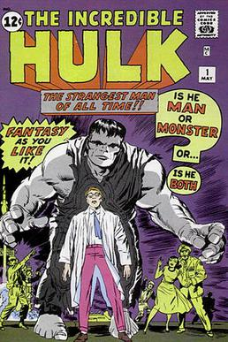
“Make friends with the Hulk”
“When you are not seen or known: that is the essence of trauma” – B van der Kolk
Listen to “The Long Arm of Childhood Trauma” & Dr Jacob Ham’s analysis of the Hulk from 30 mins 30 secs
https://inside.mountsinai.org/blog/road-to-resilience-episode-11-the-long-arm-of-childhood-trauma/

Slide 21
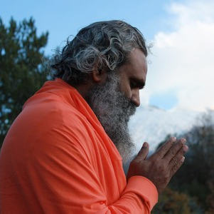
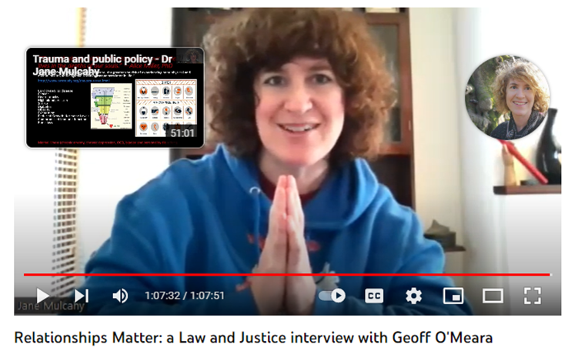
Namaste: “The Divine within me bows to the same Divine within you.”
Email: jane.mulcahy@ul.ie
@janehmul
YouTube channel: :youtube.com/c/JaneMulcahy

Slide 22
Combining research, activism & awareness raising
Submission on sentence planning, prisoner progression, rehabilitation and resettlement to the Oireachtas Committee on Justice – See Appendix to Report on Sentencing and Penal Reform, p. 111- 147 https://data.oireachtas.ie/ie/oireachtas/committee/dail/32/joint_committee_on_justice_and_equality/reports/2018/2018-05-10_report-on-penal-reform-and-sentencing_en.pdf
(PDF) Submission on the development of a criminal justice strategy (researchgate.net)
(PDF) Submission on the draft Youth Justice strategy - 30/06/20 (researchgate.net)
J. Mulcahy, Re-storying offending behaviour: a normal response to an overdose of trauma? (book chapter pre-print) at https://www.researchgate.net/publication/352464909_Re-storying_Offending_Behaviour_A_Normal_Response_to_an_Overdose_of_Trauma
J. Mulcahy, “A neurodevelopmentally aware, trauma-responsive approach to understanding risk”, Advancing Corrections (2020) (PDF) A neurodevelopmentally-aware, trauma-responsive approach to understanding risk (researchgate.net)
J. Mulcahy, “Towards ACE-Aware, trauma responsive penal policy and practice” Prison Service Journal, September 2019, 3-13, https://www.crimeandjustice.org.uk/sites/crimeandjustice.org.uk/files/PSJ%20245%20September%202019%20Journal.pdf
“The Human condition: we are all on a quest for safety” https://www.researchgate.net/publication/340309690_The_human_condition_we_are_all_on_a_quest_for_safety (polyvagal theory training notes)
“How to talk policy and influence people”: a Law and Justice interview with Dr Stephen Porges (Polyvagal theory, violence & addiction as a “neural state disorder”)
“How to talk policy and influence people”: a Law and Justice interview with Dr Bruce Perry (Neurosequential Model of Therapeutics and Founder of the Child Trauma Academy)
“How to talk policy and influence people”: a Law and Justice interview with Jim Sporleder (Former principal of Lincoln High Alternative School, the subject of Paper Tigers documentary)
“How to talk policy and influence people”: a Law and Justice interview with Judge Ginger Lerner-Wren (mental health court judge)
How to talk policy and influence people”: a Law and Justice interview with Fritzi Horstman (Compassion Prison Project) https://www.youtube.com/watch?v=cza9gkZwU8E
How to talk policy and influence people”: a Law and Justice interview with Chief Superintendent Stan Gilmour
Law and Justice interview with Dr Stephen Porges: The Science of Safety at https://soundcloud.com/jane-mulcahy/law-and-justice-interview-with-dr-stephen-porges-the-science-of-safety?si=c42cd48eed6046ae84be68c8ab1169b1
“Relationships Matter”: a Law and Justice interview with Andi Brierley at https://www.youtube.com/watch?v=sLkiuy9GodY

