Slide 1
The Journey Towards a Trauma Informed System
Probation Board NI
Conference
27 March 2023
Helen McKenzie
SBNI Director of Operations
@safeguardingni.org
https://www.safeguardingni.org/aces-and-trauma-informed-practice

Slide 2
The Safeguarding Board for Northern Ireland
Children’s Court Guardian Agency
Notes:
Maurice & Bryan

Slide 3
Brochure Publication

Slide 4
Notes:
ADD in A title slide before this

Slide 5
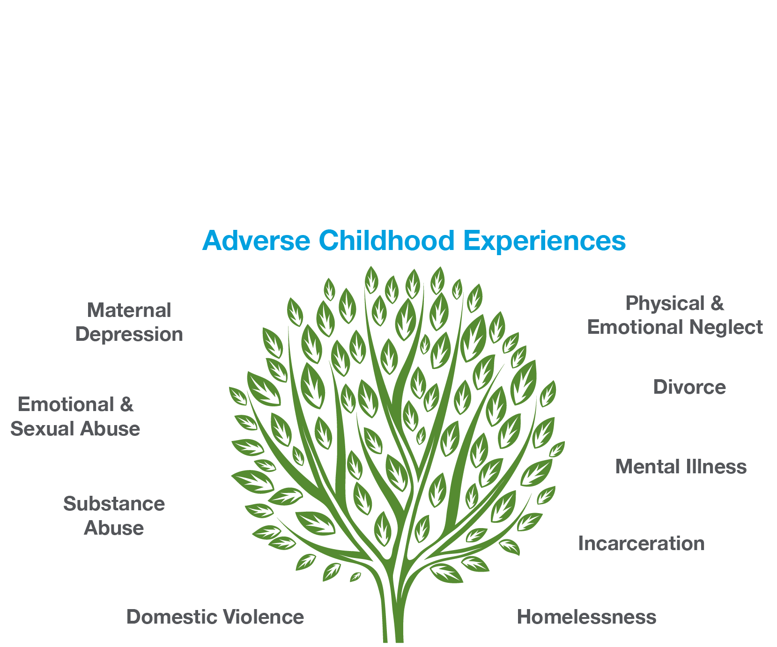
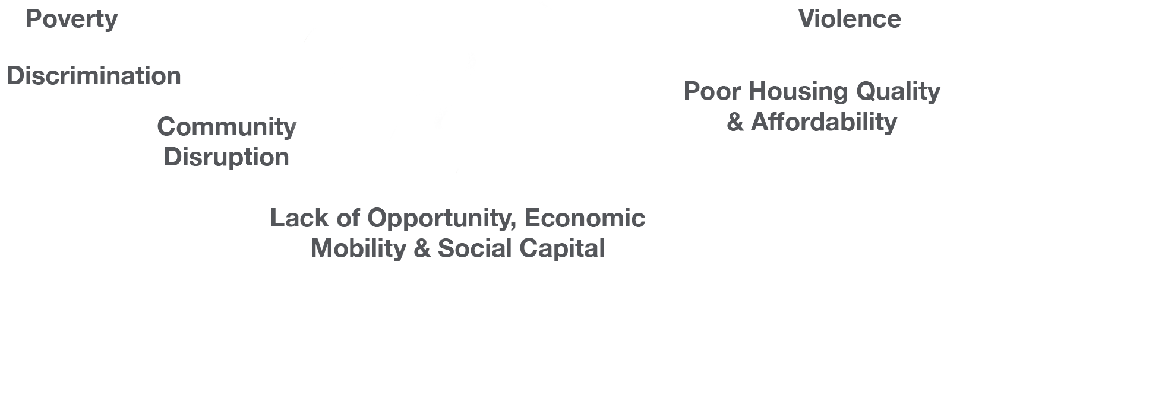

Slide 7
Notes:
While there are obvious practices that may be re-traumatising,
such as restraint or isolation, the potential for re-traumatisation
is thought to exist at all levels of care and is demonstrated
through the use of oppressive and non-collaborative approaches
to practice which violate the trust of service users and do not
take account of their wishes and feelings.

Slide 8
Notes:
We need to work towards having these principles infused in all governmental policies

Slide 10
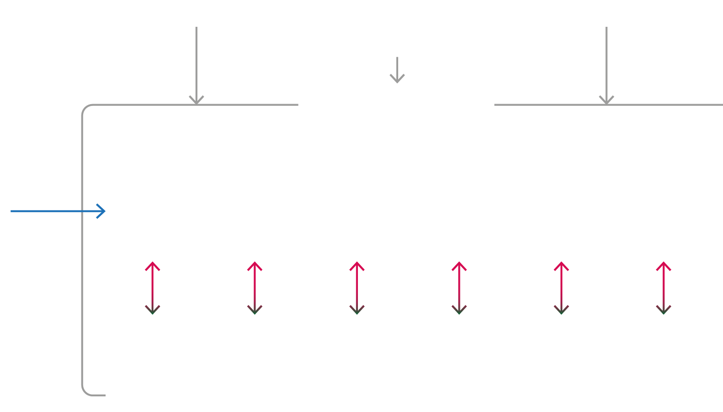

Slide 12
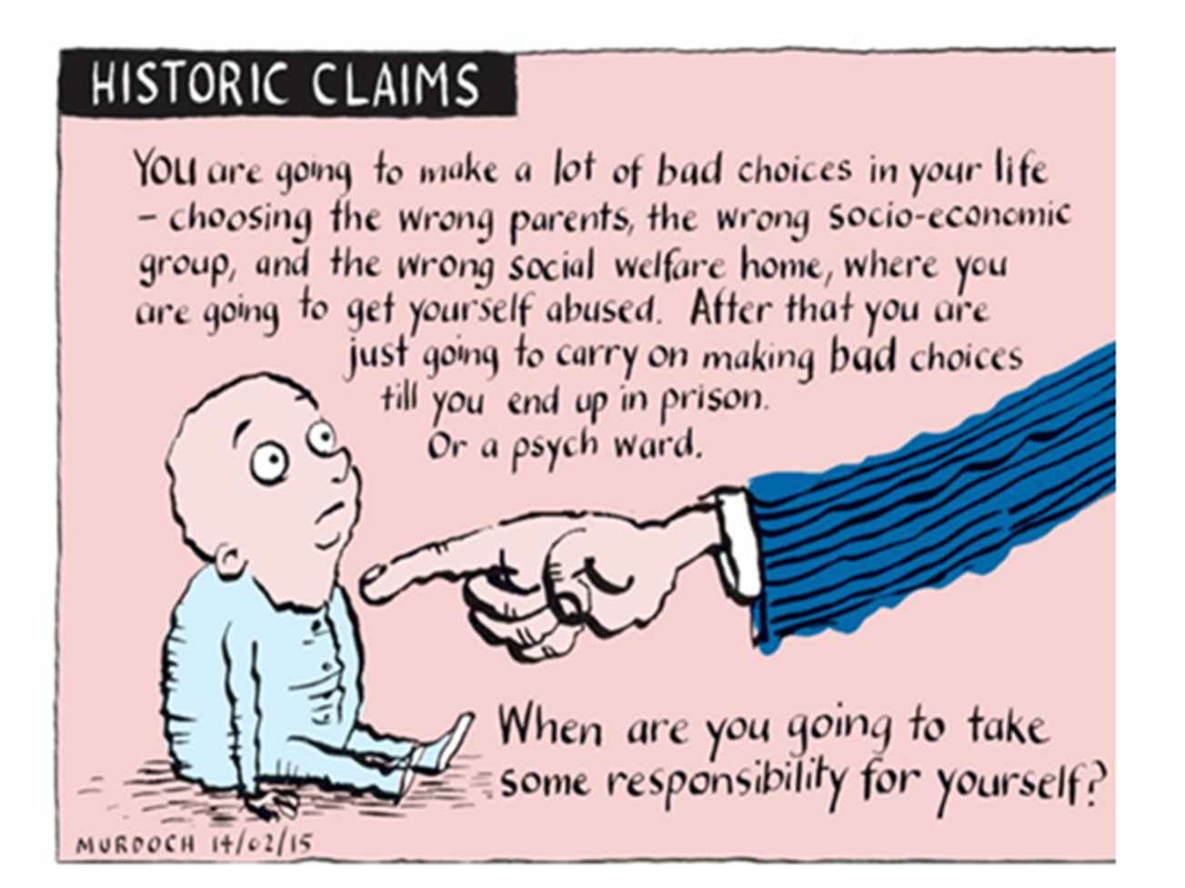
Notes:
Maurice & Bryan

